Slide 1

Wireless Analyzers and Device Forensics With Santoku Linux
Project CS6899 - Winter 2016, Dr. Levent Ertaul
By James Friely and Teja Veturi

Slide 2

Santoku Linux
What is Santoku Linux?
What’s different between Santoku and other Pen-testing Linux distributions?
Next: How to setup/install in VMWare.

Slide 3
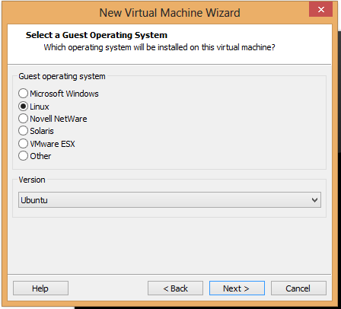
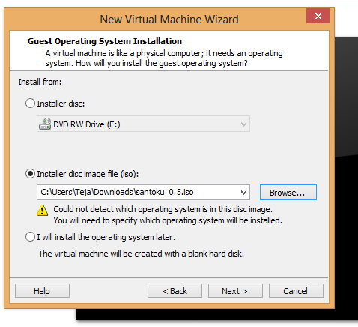
Santoku Linux - Install
Download Santoku from:
https://santoku-linux.com/
Install Steps:

Slide 4
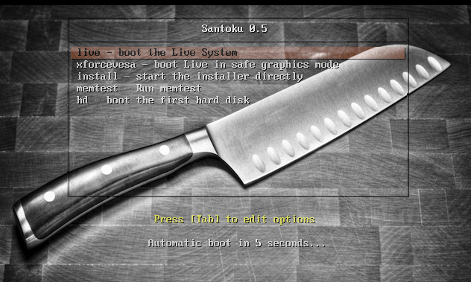

Santoku Linux - Install cont..

Slide 5
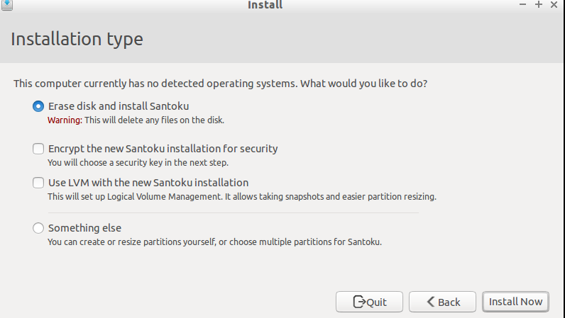
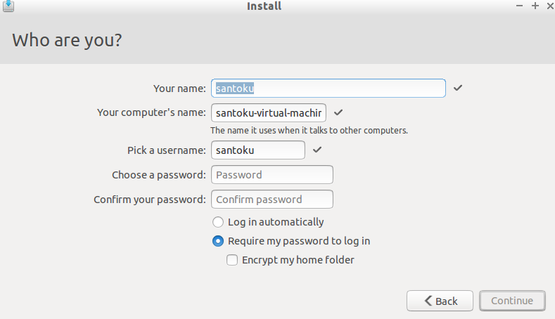
Santoku Linux - Install cont..

Slide 6
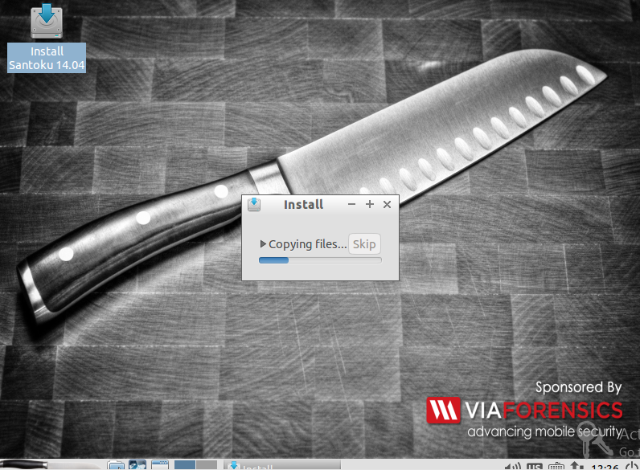
Santoku Linux - Install cont..

Slide 7
Devices Forensics & more …
Aircrack-NG
Kismet
Ubertooth
Ubertooth Spectrum Analyzer
Ubertooth Kismet
CarWhisperer
iPhone Backup Anaylzer
Android Brute Force Encryption
Android Forensics Logical OSE
Sleuth Kit
Autopsy
Yaffy2
ExifTool
Libimobile Device
Scapple

Slide 8
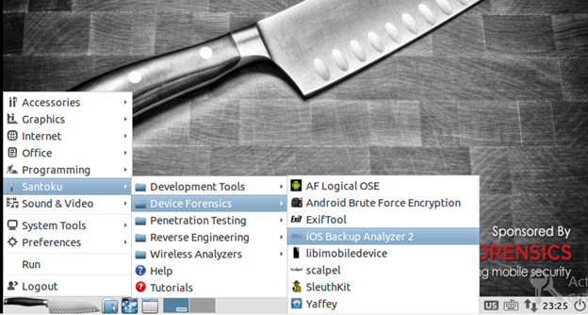
iOS Backup Analyzer 2
What iOS Backup Analyzer ?
Things you need.
Backup File (iTunes & iCloud)
iOS Backup Analyzer 2
Demo

Slide 9
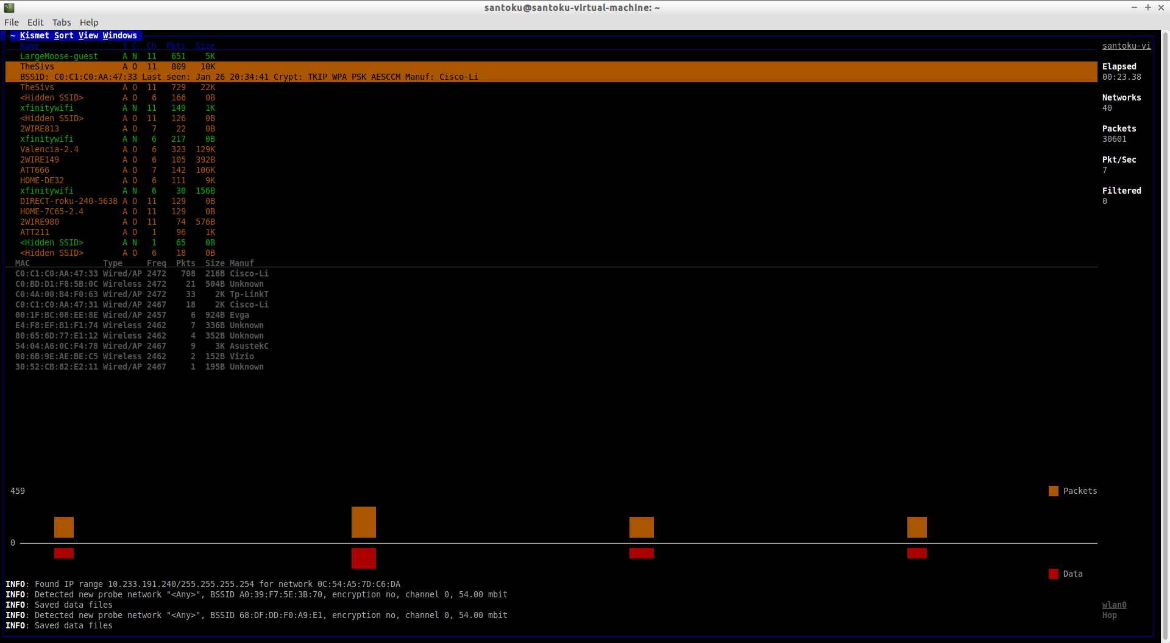
Kismet
What is Kismet?
Available Uses:
Wireless Network Detector
Capture Network Traffic
Intrusion Detection System

Slide 10
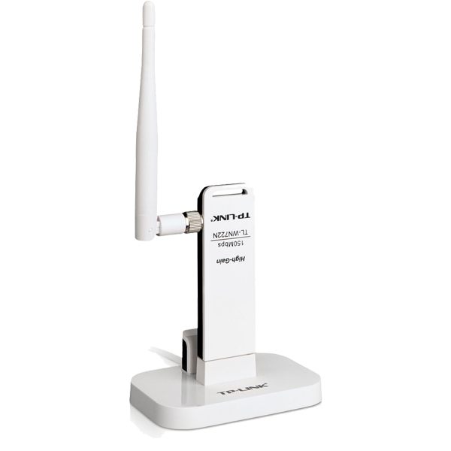
Kismet – How to install
Requirements
Wireless Adapter capable of monitor mode
Monitor mode allows to see all traffic in your vicinity
Root Privileges
To access wireless adapter, install app, save log files
Open Terminal: $ sudo apt-get install kismet
TP-LINK TL-WN722N

Slide 11
Kismet Demo
Usage Scenario – your internet has been very slow, you suspect your neighbor!
To cover
Iwconfig & airmon-ng
Sudo kismet
Wireless Network Detection
Intrusion Detection
Captured Packet Location

Slide 12
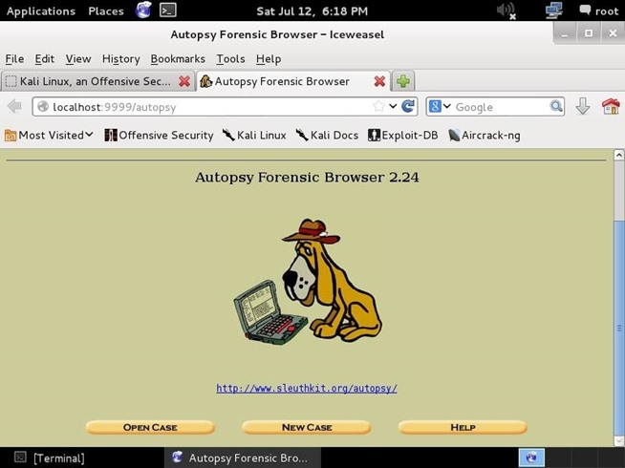
Autopsy
What is Autopsy?
Sleuth Kit vs Autopsy
Things you need.
Disk image file
Autopsy
How to install?
Demo

Slide 13
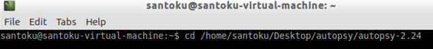
Autopsy - Setup
Download autopsy from http://www.sleuthkit.org/autopsy/v2/download.php linux version.
Open Terminal

Slide 14
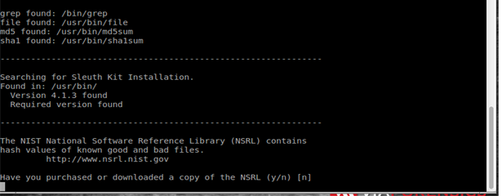
Autopsy – Setup Cont…
Type the command
$ ./configure
Choose “ NO “ for NSRL file.
National Software Reference
Library – Hash Values of good/bad
Files.

Slide 15
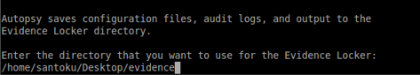
Autopsy - Demo
Evidence Locker directory path.
Demo

Slide 16
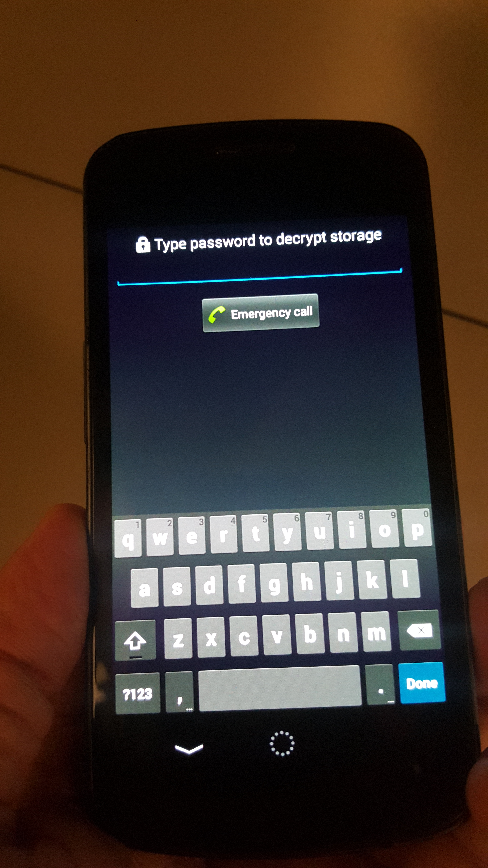
Android Brute Force Encryption
What is Android Brute Force Encryption?
What is it ABFE used for?

Slide 17
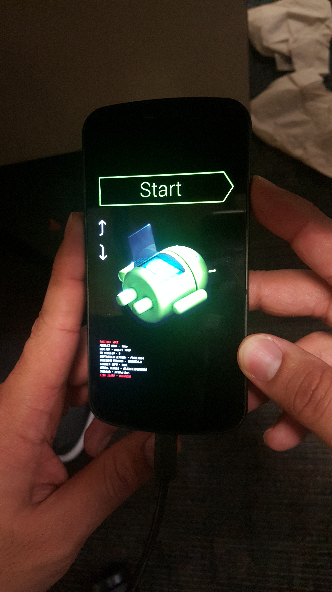
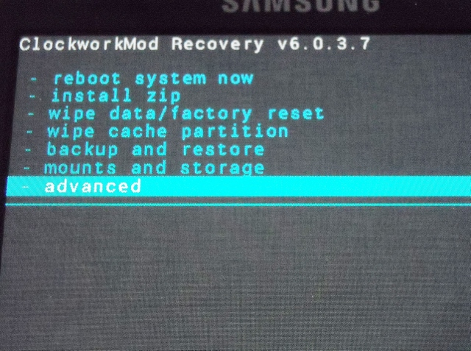
Android Brute Force Encryption - Setup
Phone Setup
Installing Clock Work Mod (Custom Recovery Tool)
www.clockworkmod.com/rommanager
Enter Fastboot Mode
HOLD Power + Vol Up + Vol Down

Slide 18
Android Brute Force Encryption - Demo
Usage Scenario – GF encrypted our phone because we were snooping!!
To cover
Enter recovery mode
Obtain Header & Footer files
Brute-force the pin#

Slide 19
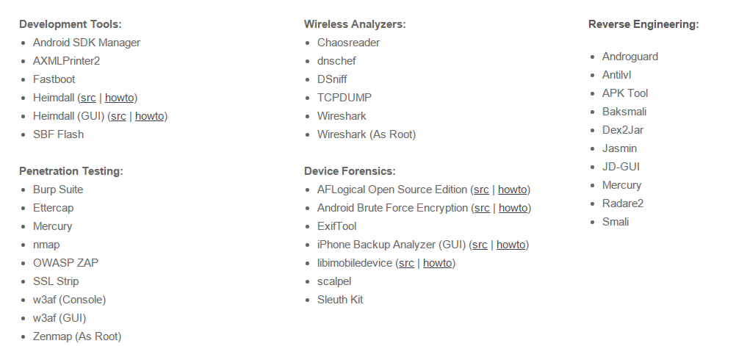
Summary
Santoku Linux
Tools Available
Questions ?

